Slide 1

Introduction to MCWC
Mobile Computing Wireless Communication
(MCWC)
GTU # 3170710
Prof.Swati R Sharma
Computer Engineering Department
swati.sharma@darshan.ac.in
(O) 9727747317

Slide 2
MCWC GTU Syllabus
Unit | Unit Name
1 | Introduction to Transmission Fundamentals and Communication
2 | Wireless Communication Technology-Cellular Wireless Networks, Antennas and Propagation, Spread Spectrum, Coding and Error Control
3 | Multiple access in Wireless System including GSM, GPRS, WiMax and Mobile IP
4 | Wi-Fi and the IEEE 802.11 Wireless LAN Standard
5 | Bluetooth
6 | Android Programming

Slide 3

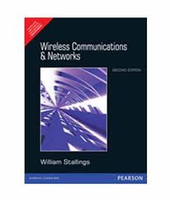

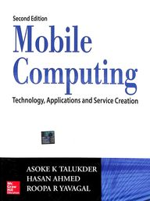
Reference Books
Unit | Reference Books
1 | Wireless Communications & Networks, Second Edition, William Stallings by Pearson
2
3 | Wireless Communications & Networks, Second Edition, William Stallings by Pearson
 | Mobile Computing Technology, Applications and service creation, Asoke K Telukder, Roopa R Yavagal by TMH
4 | Wireless Communications & Networks, Second Edition, William Stallings by Pearson
5
6 | Android Application Development Black Book, Pradeep Kothari, dreamtech press.

Slide 4
Unit-1: Introduction to Transmission Fundamentals
Mobile Computing Wireless Communication
(MCWC)
GTU # 3170710
Prof.Swati R Sharma
Computer Engineering Department
swati.sharma@darshan.ac.in
(O) 9727747317

Slide 5

What is MCWC (Mobile Computing and Wireless Communication)?
Mobile Computing
“Mobile Computing is a technology that allows transmission of
data,
voice and
video
via a computer or any other wireless enabled device without having to be connected to a fixed physical link.”

Slide 6

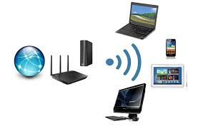










Why MCWC Subject?
University had enrolled this subject (MCWC) for the students to make them understand:
Mobile and wireless network systems such as 2G/3G/4G mobile telephony/data networks
Understand GSM , GPRS , MobileIP
Understand the working of wireless local area network, Bluetooth.
Basics Mobile App Development using Android

Slide 7
Transmission Fundamentals

Looping
Topics to be covered
Signals for Conveying Information
Time Domain Concept
Frequency Domain Concept
Relationship between Data Rate and Bandwidth
Analog and Digital Data Transmission
Reasons for Choosing Data and Signal Combinations
Channel Capacity
Transmission Media
Multiplexing

Slide 8


Signals for Conveying Information
Electromagnetic Signals:
The signals which are used as means to transmit information are known as Electromagnetic Signals.
It can be expressed as:
Function of Time
Function of Frequency

Slide 9
Time Domain Concept

Slide 10
Time Domain Concept
Analog Signal
Signal intensity varies in a smooth fashion over time
No breaks or discontinuities in the signal
Application: audio and video transmission.
Example: Temperature sensors, FM radio, Photocells, Light sensor etc.
Digital Signal
Signal intensity maintains a constant level for some period of time and then changes to another constant level
Application: Computing and digital electronics
Example: Computers, CDs, DVDs

Slide 11
Time Domain Concept
Periodic signal
An analog or digital signal pattern that repeats over time.
Aperiodic signal
An analog or digital signal pattern that doesn't repeat over time.
Equation: s(t) = s(t+T),-∞<t<+∞
where T is the period of the signal

Slide 12
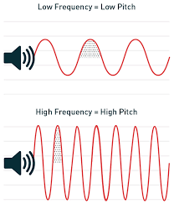
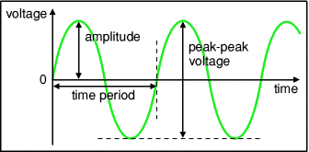
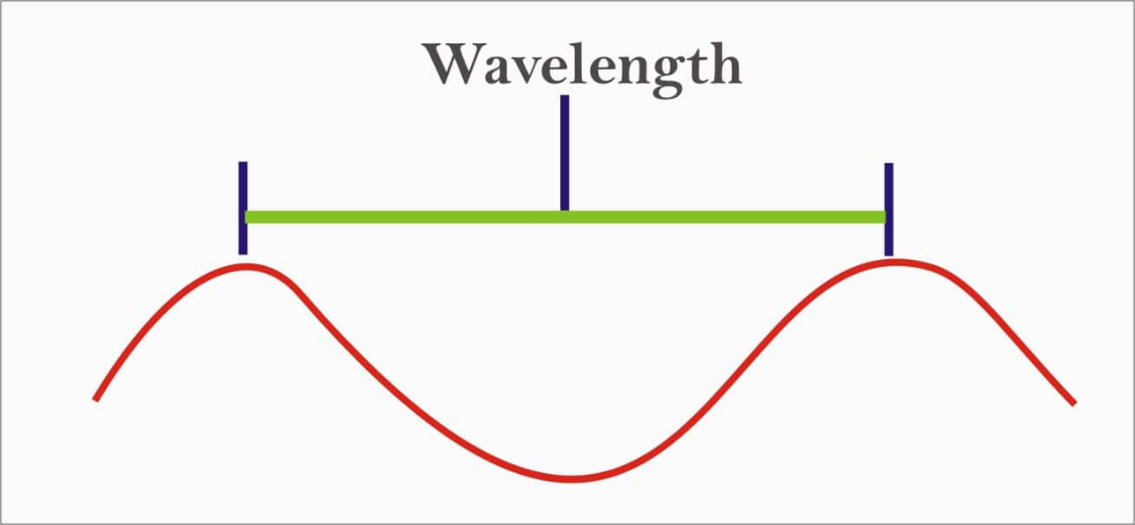
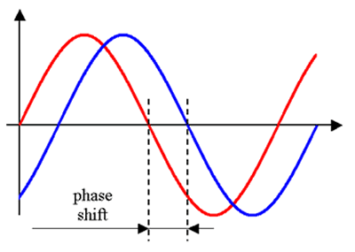
Time Domain Concept
Peak amplitude (A):
Maximum value or strength of the signal over time
Typically measured in volts
Frequency (f):
Rate, in cycles per second, or Hertz (Hz), at which the signal repeats.
Phase (φ):
A measurement of the relative position in time within a single period of a signal.
Wavelength (λ):
A distance occupied by a single cycle of the signal.
Or, the distance between two points of corresponding phase of two consecutive cycles

Slide 13
Frequency Domain Concept

Slide 14
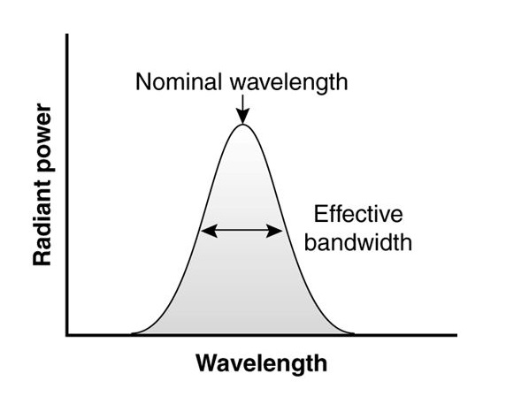
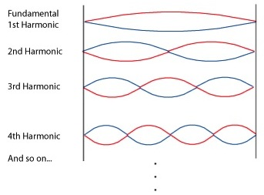
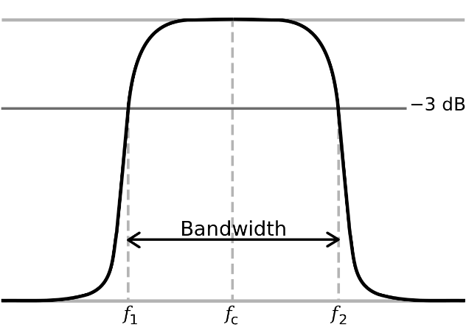
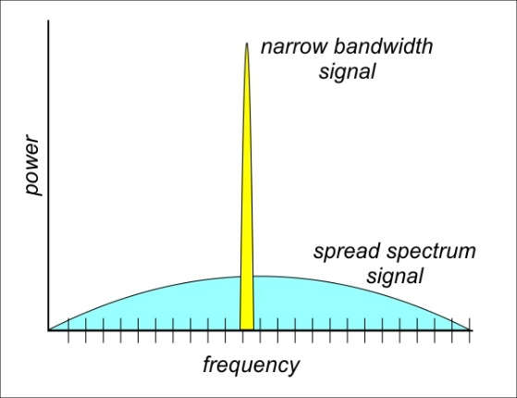
Frequency Domain Concept
Fundamental frequency: when all frequency components of a signal are integer multiples of one frequency, it’s referred to as the fundamental frequency
The period of the total signal is equal to the period of the fundamental frequency
Spectrum - Range of frequencies that a signal contains
Absolute bandwidth - Width of the spectrum of a signal
Effective bandwidth (or just bandwidth) - Narrow band of frequencies that most of the signal’s energy is contained in

Slide 15
Relationship between Data Rate and Bandwidth

Slide 16
Relationship between Data Rate and Bandwidth
The greater the bandwidth, the higher the information-carrying capacity
Conclusions
Any digital waveform will have infinite bandwidth
BUT the transmission system will limit the bandwidth that can be transmitted
AND, for any given medium, the greater the bandwidth transmitted, the greater the cost
HOWEVER, limiting the bandwidth creates distortions

Slide 17
Analog and Digital Data Transmission

Slide 18
Analog and Digital Data Transmission
Data Communication Terms
Data as entities that convey meaning, or information.
Signals are electric or electromagnetic representations of data.
Transmission is the communication of data by the propagation and processing of signals.

Slide 19
Analog vs Digital Transmission
Analog Transmission | Digital Transmission
Analog signal is a continuous signal which represents physical measurements. | Digital signals are discrete time signals generated by digital modulation.
Represented by sine waves | Represented by square waves
Uses continuous range of values to represent information | Uses discrete or discontinuous values to represent information
Stored in the form of wave signal | Stored in the form of binary bit
Analog instrument draws large power | Digital instrument draws only negligible power
Can be used in analog device only. Best suited for audio and video transmission. | Best suited for Computing and digital electronics.
Subjected to deterioration by noise during transmission | Can be noise-immune without deterioration during transmission

Slide 20
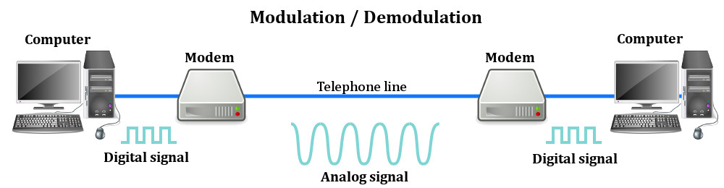
Analog and Digital Transmission Example

Slide 21
Reasons for Choosing Data and Signal Combinations

Slide 22
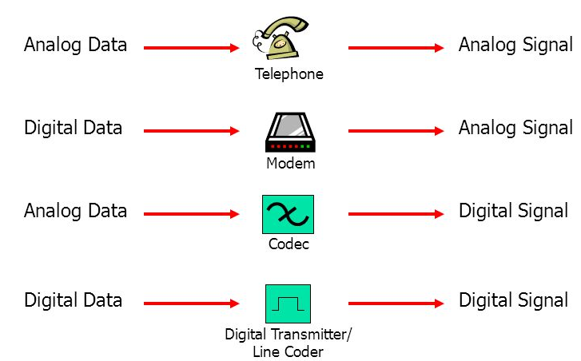


Reasons for Choosing Data and Signal Combinations

Slide 23
Channel Capacity

Slide 24
Channel Capacity
Channel Capacity: The maximum rate at which data can be transmitted over a given communication path, or channel, under given conditions.
Data rate: Rate at which data can be communicated (bps).
Data rate is the speed at which data is transferred between two devices, measured in mega bits per second (Mbps or mbps)
Bandwidth: The bandwidth of the transmitted signal as constrained by the transmitter and the nature of the transmission medium (Hertz)
Bandwidth is measured as the amount of data that can be transferred from one point to another within a network in a specific amount of time.
Noise: Average level of disturbance over the communications path
noise is an unwanted disturbance in an electrical signal
Error rate - rate at which errors occur
Error = transmit 1 and receive 0; transmit 0 and receive 1

Slide 25
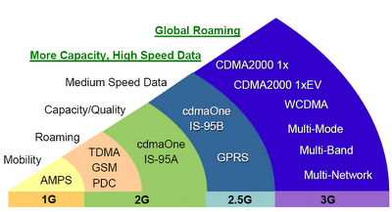
Bandwidth Comparison
Generation | Technology | Maximum Download Speed
2G | GPRS-Global Positioning Radio System, EDGE-Enhanced Data Rates for GSM Evolution | 64Kbps
3G | HSPA-High Speed Packet Access DCHSPA-Dual Access HSPA | 2Mbps
4G | LTE-Long Term Evolution | 2000Mbps to 1Gbps
5G | 5G | 1Gbps & higher

Slide 26
Transmission Impairment

Slide 27
Transmission Impairment
Impairment causes
Noise
Distortion
Attenuation

Slide 28
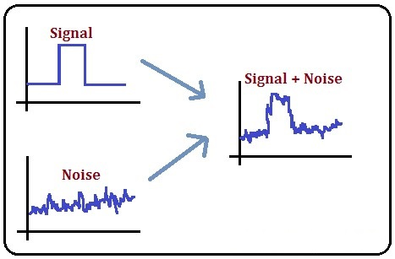
What is Noise?
Noise: The random/unwanted signal that mixes with the original signal is known as noise.
Types of Noise:
Induced noise: Noise from sources such as motors and appliances.
Crosstalk noise: Noise generates when one wire affects the other wire.
Thermal noise: Noise from movement of electrons in wire which creates an extra signal
Impulse noise: Signal with high energy that comes from lightning or power lines

Slide 29
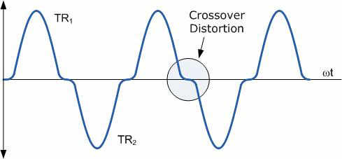
What is Distortion?
Change in the shape of signal.
Generally observed in composite signals with different frequencies.
Each frequency component has its own propagation speed travelling through a medium.
Every component arrive at different time which leads to delay distortion.

Slide 30
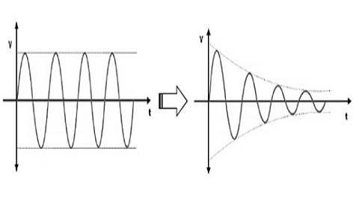
What is Attenuation?
Loss of energy.
The strength of signal decreases with increasing distance which causes loss of energy in overcoming resistance of medium.
Amplifiers are used to amplify the attenuated signal which gives the original signal back.

Slide 31
Maximum Data Rate for Noiseless and Noisy channels

Slide 32
Maximum Data Rate for Noiseless and Noisy channels
Data rate: Rate at which data can be communicated (bps).
Data rate is the speed at which data is transferred between two devices, measured in mega bits per second (Mbps or mbps)
Data rate depends upon 3 factors:
Bandwidth available
Number of levels in digital signal
The quality of the channel i.e. level of noise
To calculate data rate 2 theoretical formulas were developed:
Nyquist Bandwidth-> noiseless channel
Shannon Capacity Formula-> noisy channel

Slide 33
Nyquist Bandwidth for noiseless channel

Slide 34
Nyquist Bandwidth for noiseless channel
Nyquist Bandwidth is relationship between bandwidth and its information carrying capacity.
Nyquist's theorem specifies the maximum data rate for noiseless condition.
Nyquist's theorem states that if the rate of signal transmission is 2B(Bandwidth), then a signal with frequency no greater than B is sufficient to carry the signal rate.
There are two types of signal:
Binary Signals (Two level: 0 and 1)
Multilevel Signals (More than two level)

Slide 35
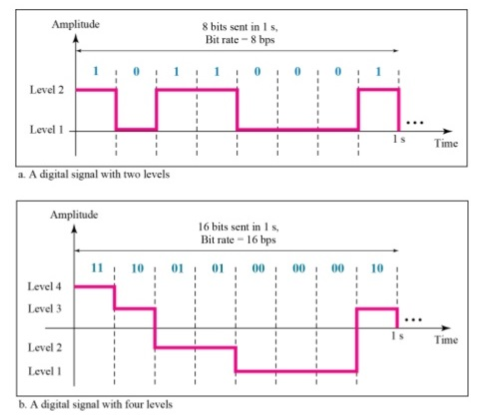
Nyquist Bandwidth for noiseless channel
Nyquist formula for maximum bitrate in bits per second(bps) for noiseless channel.
For binary signals (two voltage levels)
C: Channel Capacity
B: Bandwidth
For multilevel signaling (more than two voltage levels)
M:Number of discrete signal or voltage levels
C: Channel Capacity
B: Bandwidth
Binary Signal
C = 2B
C = 2B log₂ M
Multilevel Signal

Slide 36
Nyquist Bandwidth: Example
Given: B=3100 Hz
Formula for binary signal: C = 2B
C = 2 X 3100
Answer: C = 6200 bps(bits per second)
Therefore, channel capacity C is 6200 bps(bits per second) if bandwidth B is 3100Hz.
Example 1: | If the signal transmitted is binary and bandwidth is 3100 Hz then calculate the channel capacity.
Solution 1:

Slide 37
Nyquist Bandwidth: Example
Example 2: | If the signal transmitted is multilevel and bandwidth is 3100 Hz with 8 possible voltage/signal levels are used then calculate the channel capacity.
Given: Bandwidth B=3100 Hz
Signal Level M=8
Formula for Multilevel signal: C = 2B log₂ M
C = 2 X 3100 X log₂ 8 (log₂ 8 = 3)
C = 2 X 3100 X 3
Answer: C = 18,600 bps(bits per second)
Conclusion:
Therefore, for a given bandwidth, the data rate can be increased by increasing the number of different signal elements(M).
Nyquist's formula indicates that, doubling the bandwidth doubles data rate.
Solution 2:

Slide 38
Signal-to-Noise Ratio

Slide 39
Signal-to-Noise Ratio
Ratio of the power in a signal to the power contained in the noise that’s present at a particular point in the transmission
Typically measured at a receiver end
Signal-to-noise ratio (SNR, or S/N)
A high SNR means a high-quality signal, low number of required intermediate repeaters
SNR sets upper bound on achievable data rate.
A high SNR, means a high-quality signal.

Slide 40
Shannon Capacity Formula for noisy channel

Slide 41
Shannon Capacity Formula for noisy channel
In real, we cannot have a noiseless channel; the channel is always noisy.
Shannon capacity specifies the theoretical highest data rate for a noisy channel.
Shannon Capacity Formula:
C: Channel Capacity(bps)
B: Bandwidth(Hz)
In practice, only much lower rates achieved
Formula assumes white noise (thermal noise)
Impulse noise is not accounted for
Attenuation distortion or delay distortion not accounted for

Slide 42
Nyquist and Shannon Formulations

Slide 43
Nyquist and Shannon Formulations
Example1: | The spectrum of channel is between 3MHz and 4MHz and SNR is 24_{DB}. Find out channel capacity using Shannon formula.
Note:
SNR_{dB} = 10 log₁₀(SNR)
when stated in dB, so be careful about mixing the two logarithmic bases in this problem.
The SNR quantity in the Shannon capacity equation is numerical (not dB) and the logarithm is base 2.
SNR of 24dB is numerically equal to 251
SNR_{dB} = 24_{dB} = 10log₁₀(SNR)
24=10log₁₀(SNR)
2.4=log₁₀(SNR)
SNR=10^{2.4}= 251
Given: Bandwidth B=4MHz–3MHz=1MHz
SNR=24_{dB}=10log₁₀(SNR)=251
Using Shannon’s formula
C = B * log₂(1+SNR)
= 1MHz * log₂(1+251)
= 10⁶ * log₂(1+251)
≈ 10⁶ * 8
C = 8Mbps
Solution:
log_{b}x=y b^{y}=x

Slide 44
Nyquist and Shannon Formulations
Example2: | We have a channel with 1-MHz bandwidth. The SNR =63. What are the appropriate Bit rate and Signal level using Shannon’s and Nyquist’s Formula? [GTU Winter 2019]
Given: Bandwidth B = 1MHz
SNR = 63
Find: Bit rate C
Using Shannon’s formula
C = B * log₂(1+SNR)
= 1MHz * log₂(1+63)
= 10⁶ * log₂(1+63)
≈ 10⁶ * 6
C = 6Mbps
Find: Signal level M, if C=6Mbps
Using Nyquist’s Formula
C = 2B * log₂M
6Mbps = 2 * 1MHz * log₂M
6*10⁶ = 2*(1*10⁶) * log₂M
3 = log₂M
M = 2³
M = 8
Solution:
Solution:

Slide 45
Nyquist and Shannon Formulations
Example3: | A typical voice channel has SNR as 30dB and Bandwidth as 2.7KHz. Calculate the approximate maximum information capacity of the channel? [GTU Winter 2019]
Note:
SNR_{dB} = 10 log₁₀(SNR)
when stated in dB, so be careful about mixing the two logarithmic bases in this problem.
The SNR quantity in the Shannon capacity equation is numerical (not dB) and the logarithm is base 2.
SNR of 30dB is numerically equal to 1000
SNRdB = 30dB = 10log₁₀(SNR)
30=10log₁₀(SNR)
3=log₁₀(SNR)
SNR =10³= 1000
Given: Bandwidth B=2.7KHz
SNR=30_{dB}=10log₁₀(SNR)=1000
Using Shannon’s formula
C = B * log₂(1+SNR)
= 2.7KHz * log₂(1+1000)
= (2.7*10³) * log₂(1+1000)
= 2700 * 9.967 = 26910.99
≈ 27000
C ≈ 27Kbps
Solution:

Slide 46
Exercise
1. | If the SNR of wireless channel 10dB then calculate maximum data rate through channel with bandwidth of 200 KHz. Answer[691.8 kbps]
Note:
SNR_{dB} = 10 log₁₀(SNR)
when stated in dB, so be careful about mixing the two logarithmic bases in this problem.
The SNR quantity in the Shannon capacity equation is numerical (not dB) and the logarithm is base 2.
SNR of 10dB is numerically equal to 10
SNRdB = 10dB = 10log₁₀(SNR)
10=10log₁₀(SNR)
1=log₁₀(SNR)
SNR =10¹= 10
Given: Bandwidth B=200KHz
SNR=10_{dB}=10log₁₀(SNR)=10
Using Shannon’s formula
C = B * log₂(1+SNR)

Slide 47
Exercise
1. | If the SNR of wireless channel 10dB then calculate maximum data rate through channel with bandwidth of 200 KHz. Answer[691.8 kbps]
Note:
SNR_{dB} = 10 log₁₀(SNR)
when stated in dB, so be careful about mixing the two logarithmic bases in this problem.
The SNR quantity in the Shannon capacity equation is numerical (not dB) and the logarithm is base 2.
SNR of 10dB is numerically equal to 10
SNRdB = 10dB = 10log₁₀(SNR)
10=10log₁₀(SNR)
1=log₁₀(SNR)
SNR =10¹= 10
Given: Bandwidth B=200KHz
SNR=10_{dB}=10log₁₀(SNR)=10
Using Shannon’s formula
C = B * log₂(1+SNR)
= 200KHz * log₂(1+10)
= (200*10³) * log₂(1+10)
= 200*10³ * 3.45943
= 691.886 * 10³
C = 691.89 Kbps

Slide 48
Classifications of Transmission Media

Slide 49
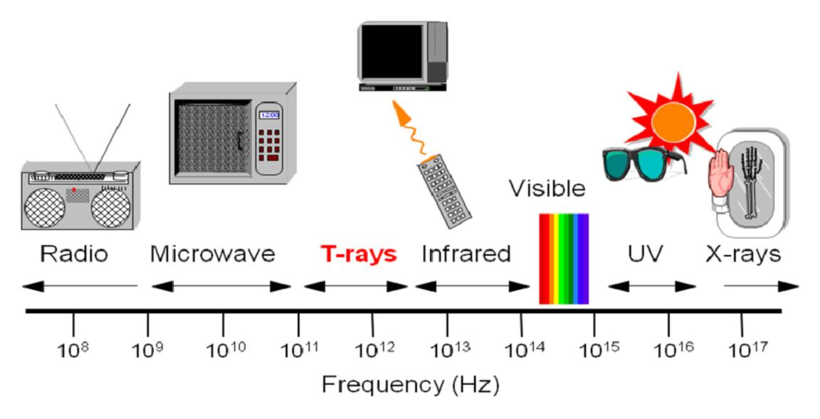
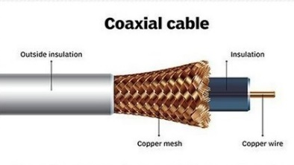
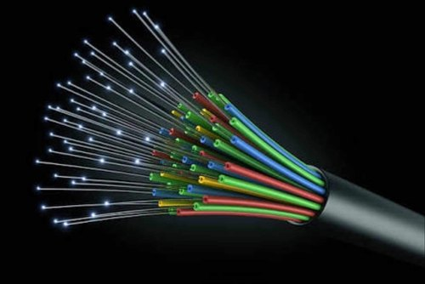
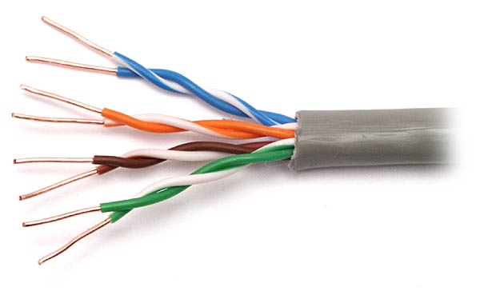
Classifications of Transmission Media
Physical path between transmitter and receiver
Transmission Media
Waves are guided along a solid medium
Guided
Media
Unguided
Media
wireless transmission
Co-axial Cable
Fibre Optics
Twisted Pair
Radio waves
Micro waves
Infrared

Slide 50
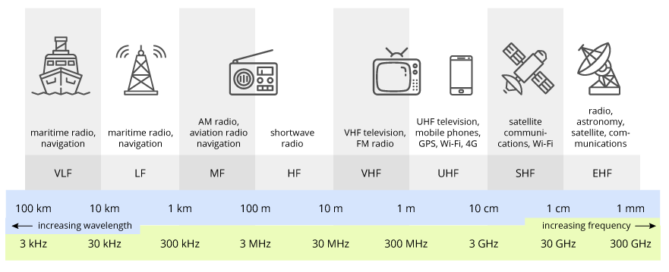
General Frequency Ranges
VLF | Very Low Frequency | VHF | Very High Frequency
LF | Low Frequency | UHF | Ultra High Frequency
MF | Medium Frequency | SHF | Super High Frequency
HF | High Frequency | EHF | Extremely High Frequency
Frequency and wavelength are
inversely proportional to each other.

Slide 51
General Frequency Ranges
Sr. | Band Name | Frequency | Wavelength | Application
1 | Very Low Frequency-VLF | 3–30 kHz | 100–10 km | Navigation, time signals, submarine communication, wireless heart rate monitors, geophysics etc.
2 | Low Frequency-LF | 30–300 kHz | 10–1 km | AM longwave broadcasting (Europe and parts of Asia), RFID, amateur radio
3 | Medium Frequency-MF | 300–3,000 kHz | 1,000–100 m | AM (medium-wave) broadcasts, amateur radio, avalanche beacons
4 | High Frequency-HF | 3–30 MHz | 100–10 m | Shortwave broadcasts, citizens band radio, aviation communications, RFID, radar, marine and mobile radio telephony
5 | Very High Frequency-VHF | 30–300 MHz | 10–1 m | FM, television broadcasts, ground-to-aircraft and aircraft-to-aircraft communications, land mobile and maritime mobile communications, weather radio
6 | Ultra High Frequency-UHF | 300–3,000 MHz | 1–0.1 m | Television broadcasts, microwave oven, radio astronomy, mobile phones, wireless LAN, Bluetooth, ZigBee, GPS, satellite radio, Remote control systems
7 | Super High Frequency-SHF | 3–30 GHz | 100–10 mm | Wireless LAN, most modern radars, communications satellites, cable and satellite television broadcasting
8 | Extremely High Frequency-EHF | 30–300 GHz | 10–1 mm | Microwave remote sensing, directed-energy weapon, millimetre wave scanner, wireless LAN (802.11ad)

Slide 52
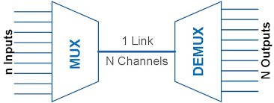
Multiplexing
Definition:
Multiplexing is a technique
used to combine &
send the multiple data streams
over a single medium.
The process of combining the data streams is known as multiplexing &
hardware used for multiplexing is known as a multiplexer.

Slide 53
Why Multiplexing?
Cost per kbps of transmission facility declines with an increase in the data rate
Cost of transmission and receiving equipment declines with increased data rate
When multiple signals share the common medium, there is a possibility of collision. Multiplexing concept is used to avoid such collision.
The bandwidth of a medium can be utilized effectively.

Slide 54
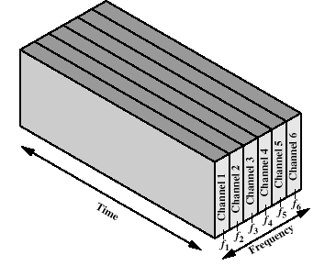
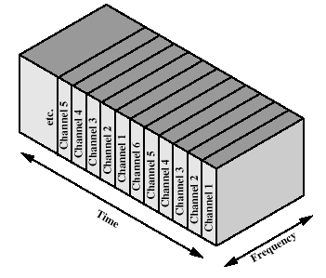
Types of Multiplexers
Multiplexers
Analog
Digital
FDM
Frequency Division Multiplexing
TDM
Time Division Multiplexing

Slide 55
Multiplexing Techniques: Frequency Division Multiplexing (FDM)
Analog technique
FDM is a technique in which the available bandwidth of a single transmission medium is subdivided into several channels.
The pivotal aim of the FDM is to subdivide the available bandwidth into different frequency channels and allocate them to different devices.
FDM is mainly used in radio broadcasts and TV networks.

Slide 56
Multiplexing Techniques: Time Division Multiplexing (TDM)
Digital technique
In FDM, all signals operate at the same time with different frequency, but in case of TDM, all signals operate at the same frequency with different time.
In TDM, the total time available in the channel is distributed among different users. Therefore, each user is allocated with different time interval known as a Time slot at which data is to be transmitted by the sender.
A user takes control of the channel for a fixed amount of time.
In TDM, data is not transmitted simultaneously rather the data is transmitted one-by-one.
TDM is mainly used in Telephone lines, ISDN (Integrated Services Digital Network) telephone lines.

Slide 57
Communication Networks

Looping
Topics to be covered
LANs, MANs and WANs
Switching Techniques
Circuit Switching
Packet Switching
Circuit Switching vs Packet Switching

Slide 58



LANs, MANs and WANs
Full-form | Local Area Network | Metropolitan Area Network | Wide Area Network
Transmission speed | High comparatively | Average comparatively | Low comparatively
Propagation delay | Short | Moderate | High
Congestion | Low comparatively | Average comparatively | High comparatively
Maintenance | Easy | Difficult than LAN | Difficult than MAN and LAN
Scope | Small (1 to 10 Km) e.g. Small building, cluster of building, organization | Multiple Building or Society or in a city.(upto 100 Km area) | Multiple city or country (beyone 100Km)
Ownership | Private | Private or public | Private or public
Medium | Cable | Telephone lines | Telephone lines, satellite

Slide 59
Switching Techniques

Slide 60
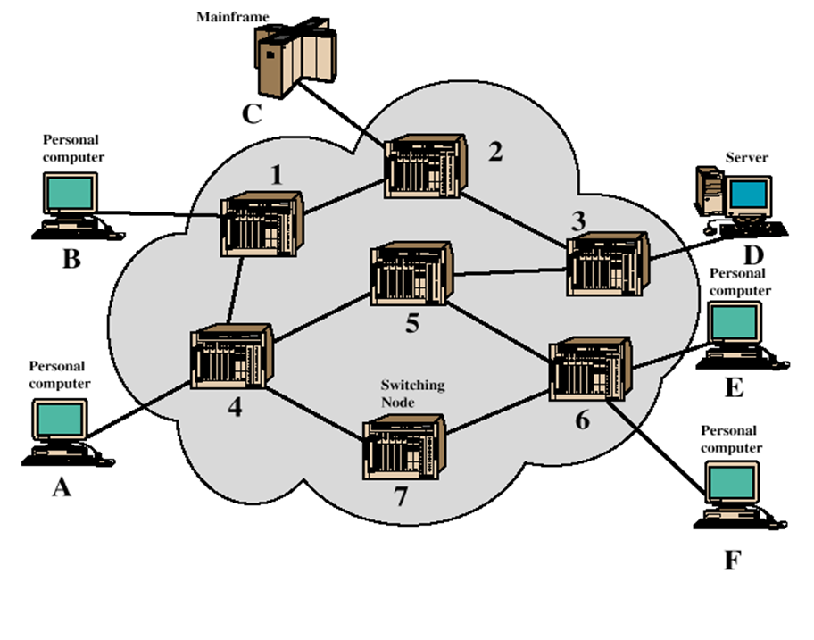
Switching Techniques

Slide 61
Switching Techniques
For transmission of data beyond a local area, communication is typically achieved by transmitting data from source to destination through a network of intermediate switching nodes.
Purpose is to provide a switching facility that will move the data from node to node until they reach their destination.
The nodes are connected to each other in some topology by transmission links.
Each station attaches to a node, and the collection of nodes is referred to as a communication network.
Two types of Switching Techniques:
Circuit Switching
Packet Switching

Slide 62
Circuit Switching

Slide 63
Circuit Switching
Connection-oriented networks
Dedicated communication path between two stations
The path is reserved for the single pair of end users
This technique is suitable for long continuous transmission, like voice calls.
E.g. public telephone network

Slide 64
Packet Switching

Slide 65
Packet Switching
Connectionless networks
Each node determines next leg of transmission for each packet.
Message is divided and grouped into a number of units called packets that are individually routed from the source to the destination.
This technique guarantees better resource utilization.
E.g. data transfer

Slide 66
Circuit Switching vs Packet Switching

Slide 67
Circuit Switching vs Packet Switching
Circuit Switching | Packet Switching
It is a connection oriented network switching technique. | It is a connectionless network switching technique.
Dedicated path has to be established between the source and the destination before transfer of data commences. | There is no need to establish a dedicated path from the source to the destination.
Data packets are routed along the same dedicated path. | Different data packets follow different paths.
Initially designed for voice transfer. | Initially designed for data transfer.
It is not a store and forward transmission. | It is store and forward transmission.
Data is processed and transmitted by the source station only. | Data is processed and transmitted, not only by the source station but at each switching station.
There are 3 phases in circuit switching i) Connection Establishment ii) Data Transfer iii) Connection Released | In Packet switching directly data transfer takes place .

Slide 68
GTU Questions
Sr. | Question | Marks | Year
1. | Differentiate: Circuit Switching and Packet Switching. | 7 | Win’17,18 Sum’18,19
2. | Explain the Nyquist Theorem. Find the relationship among the following terms: Channel Capacity(C), Bandwidth(B) and Signal-to-Noise Ratio(SNR). | 7 3 | Sum’18 Win’19
3. | Define the term Multiplexing. Explain the FDM and TDM with one example each. | 4 7 | Sum’18 Sum’19
4. | We have a channel with a 1-MHz bandwidth. The SNR value for this channel is 63. What are the appropriate Bit rate and Signal level using Shannon’s and Nyquist’s Formula? | 7 | Win’19
5. | A typical voice channel has SNR as 30dB and Bandwidth as 2.7KHz. Calculate the approximate maximum information capacity of the channel? | 7 | Win’19
6. | Define: Peak Amplitude (A), Frequency (f) and Period (T). | 3 | Win’17
7. | Compare the LAN and WAN. | 3 | Sum’18
8. | What is noise? Discuss briefly types of noise and its effect on transmission signal. | 4 | Win’18
9. | What do you mean by channel capacity? What are the factors that affect it? | 3 | Win’17,18

Slide 69
References
Book: | Wireless Communications & Networks, Second Edition, William Stallings by Pearson

Slide 70
Thank You

